Slide 1
Part 5 : Entity to DTO Mapping
arnaud.nauwynck@gmail.com
Rest Json using JPA … Entity to DTO, Orika Mapper,
problems with DTO to Entity
This document:
http://github.com/arnaud-nauwynck/Presentations/java/ Architecture-Design-part5-EntityToDTO.pdf

Slide 2
Exposing DTO + API using Internal Entity Mapping … entity2Dto / dto2Entity

Slide 3
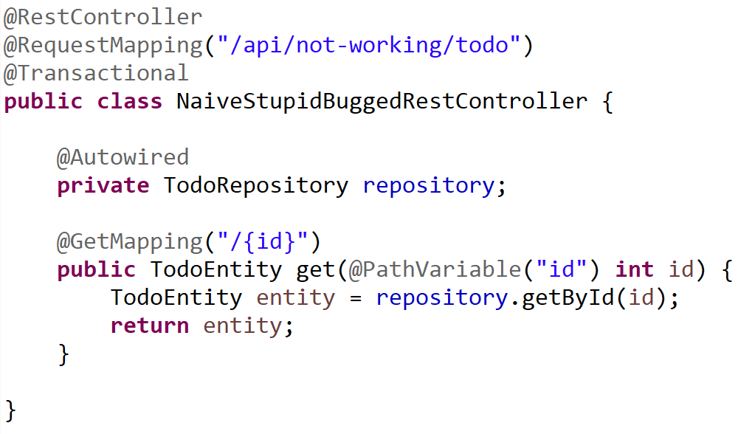
Naive (Not working) @Entity to JSON
Entity class maybe
not JSON compatible
Entity object invalid
After transaction commit
(managed lifecycle)

Slide 4
Why Not using 1 class Entity = DTO ?
0/ does NOT work except on simplicitic entities (Transaction)
1/ internal database is PRIVATE, implementation specific
!= external API is publicly specified
2/ Decoupling helps evolutivity
3/ projection-cuts for complex Entities graph
with cyclic dependencies parent-child (@ManyToOne(mappedBy..) )
4/ several DTO classes/APIs for a single Entity class
5/ Do not use HACKS like @JsonIgnore… (see 0/, 1/, 2/, 3/, 4/ )

Slide 5
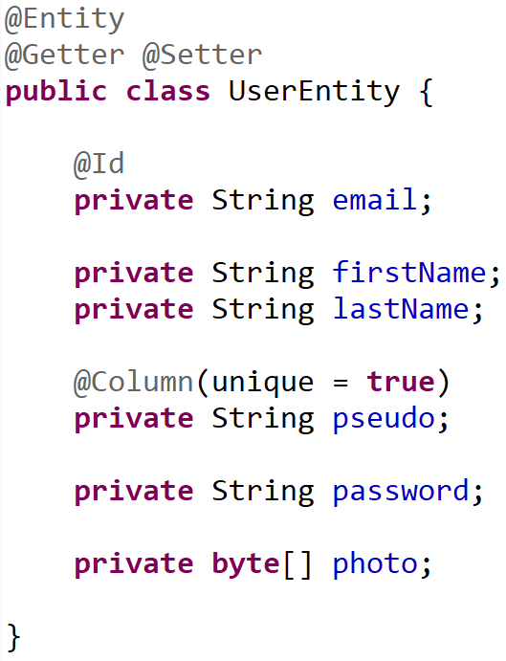
Example Entity class .. Do not export all
Personnal data
Do not publish
Critical Security data
never publish !!
( Except for owner )
High volume data
export only explicitly demanded

Slide 6
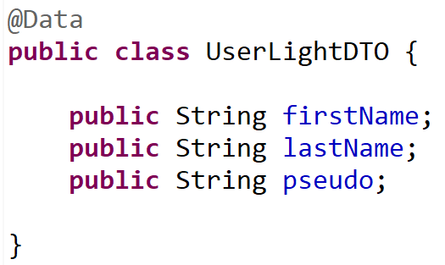
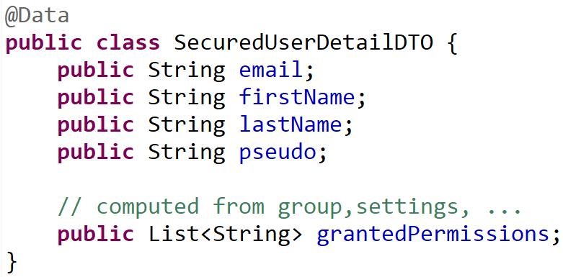
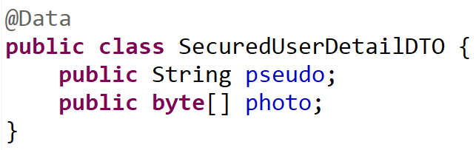
1 Entity class <-> Several specific DTO classes
Default mapping
Owner personal view
Public detailed view (high data volume)

Slide 7
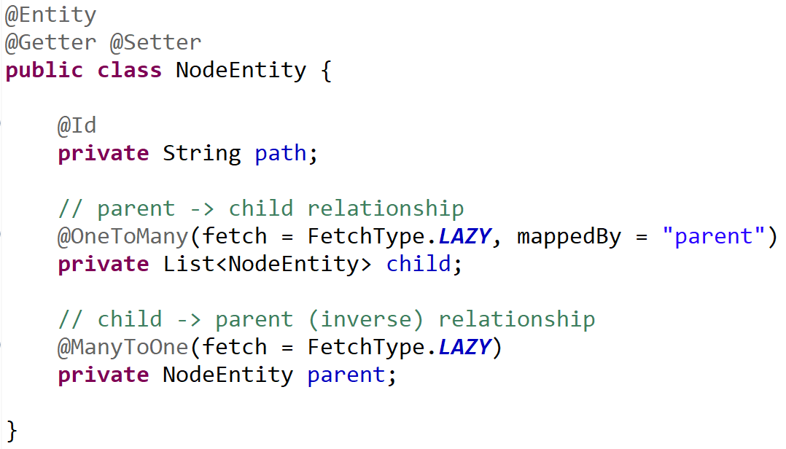
Entity -> Projection DTOs = « Cutting » relations
0..1 parent
NodeEntity
* child
Projection Parent->Children (recursive)
TreeNodeDTO
* child
Projection Child->Parent (recursive)
AncestorNodeDTO
0..1 parent

Slide 8
Reminder Part 2 … Entity lifecycle in Session

Slide 9
Entity : Lifecycle managed by Session (Transaction)
Level1Cache
(=Session )
Read-Write, single-thread
Thread
Begin transaction
@Transactional
method () {
XA (Transaction)
e1 = em.save(new Entity())
e2 = e1.getField()
e3List = repo.findBy(..)
end transaction
} // implicit try-catch-finally
prepareXA => flush Entity changes
Commit XA => commit JDBC
Entity lifecycle ends with XA commit/rollback

Slide 10
Copy Entity data to Transfer before Commit
Thread
Session
Begin transaction
@Transactional
method () {
XA (Transaction)
e = repo.findBy(..)
Dto res = new DTO()
// copy dto entity
res.setField1( e.getField1() );
return res;
end transaction
} // implicit try-catch-finally
Entity lifecycle ends with XA commit/rollback
DTO have no lifecycle ends (only GC to free)

Slide 11
2 Rules : a/ use DTOs != Entities b/ use RestController != (Transactional) Service
Thread
@RestController @RequestMapping
{
Api input checks
@Transactional @Service
{
JPA queries (find entity) / fill from dto
Functional code
entities
Entity to dto
}
dtos
Api output result
}

Slide 12
But it seems to works?? (in « normal » cases)
Bad default value in springboot
To please newbies trying JPA with left hands
Springboot explicitly WARN to change it
Do not simply remove the warn !!! Code is buggy

Slide 13
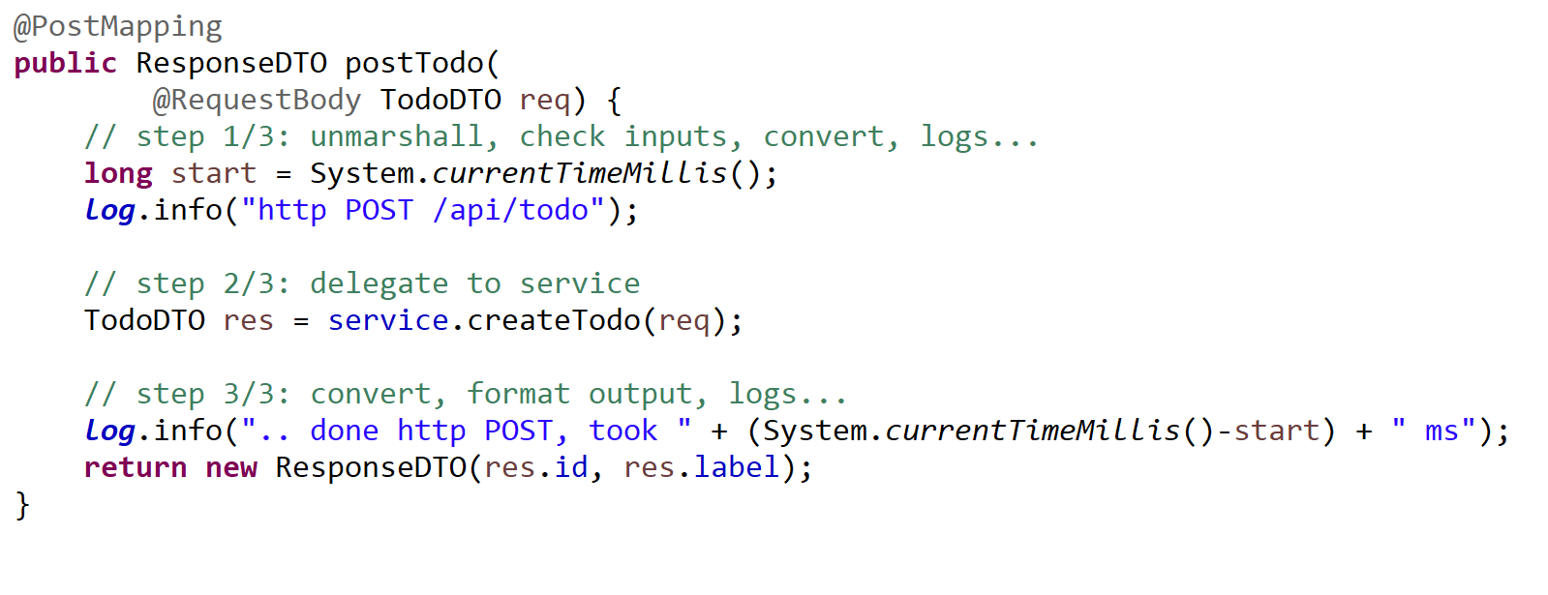
Controller Method Pattern { unmarshal / delegate / marshall }

Slide 14
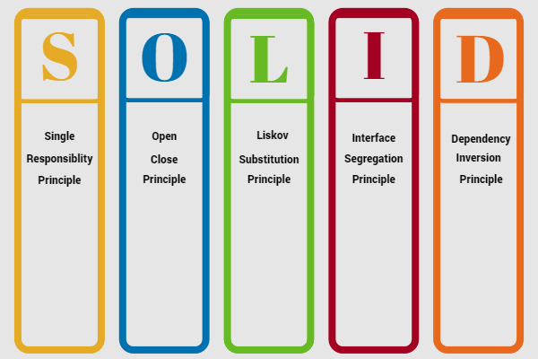
« solid » principles

Slide 15
SOLID RestController …. S = Single
A RestController does only 1 thing :
controls (maps) http Rest requests to Java methods
… delegate all others things to injected Service

Slide 16
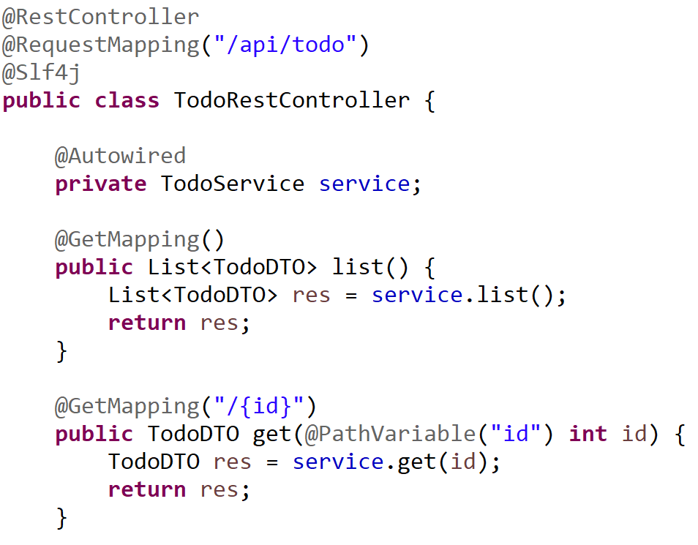
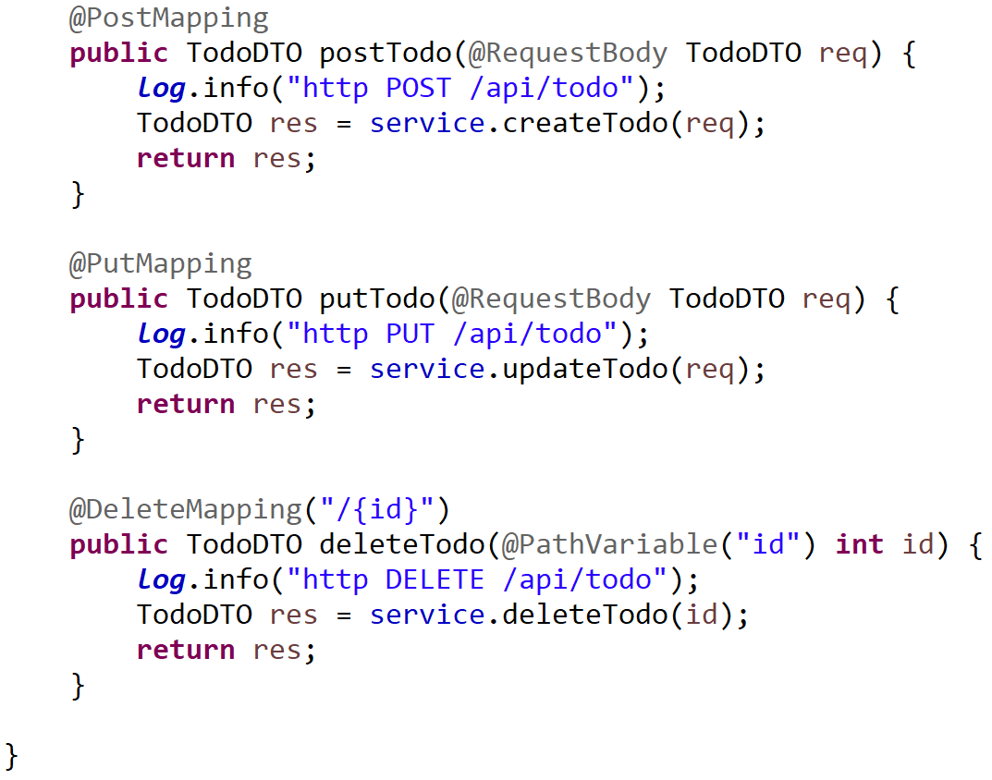
Typical CRUD Rest Controller

Slide 17
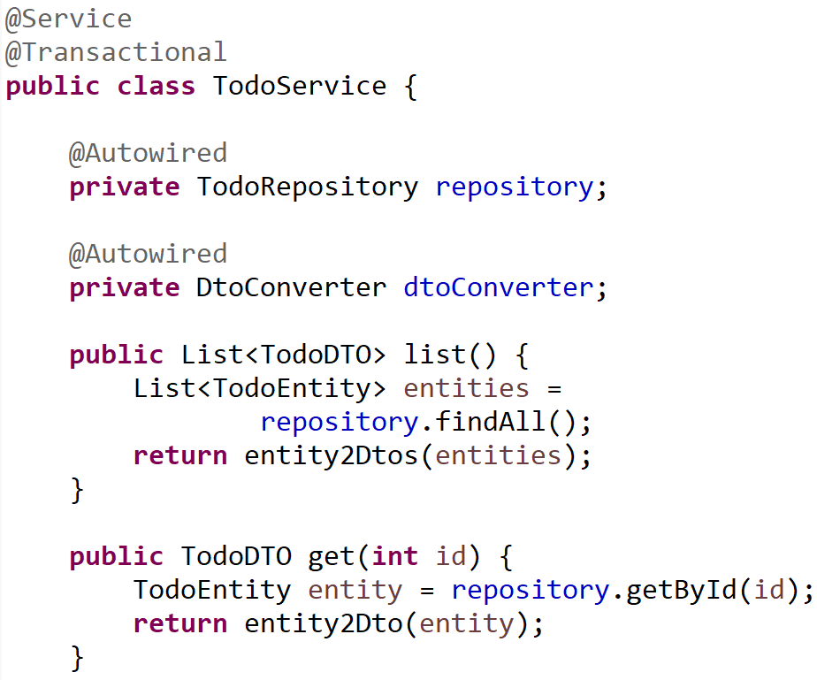
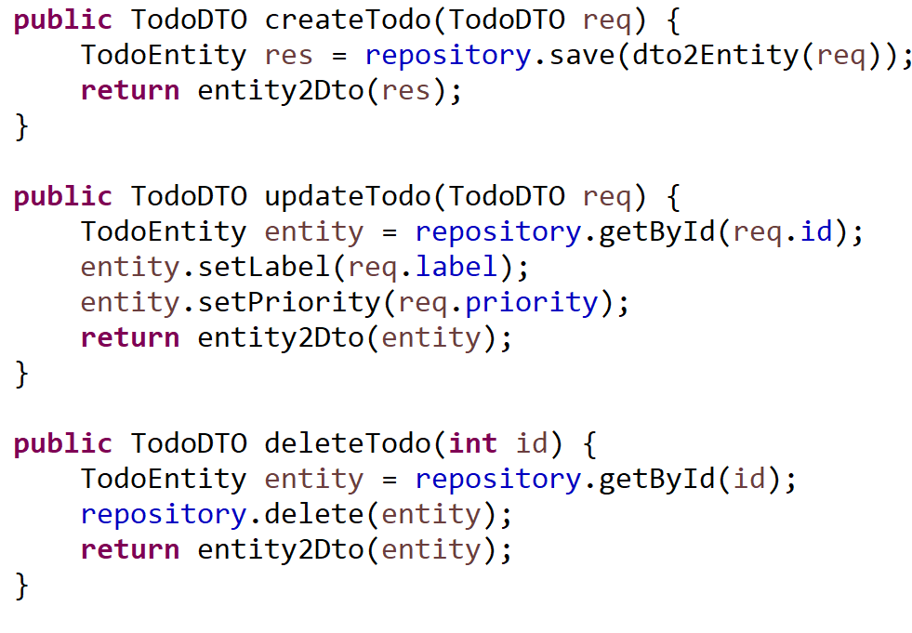
Typical CRUD Transactional Service (1/2)

Slide 18
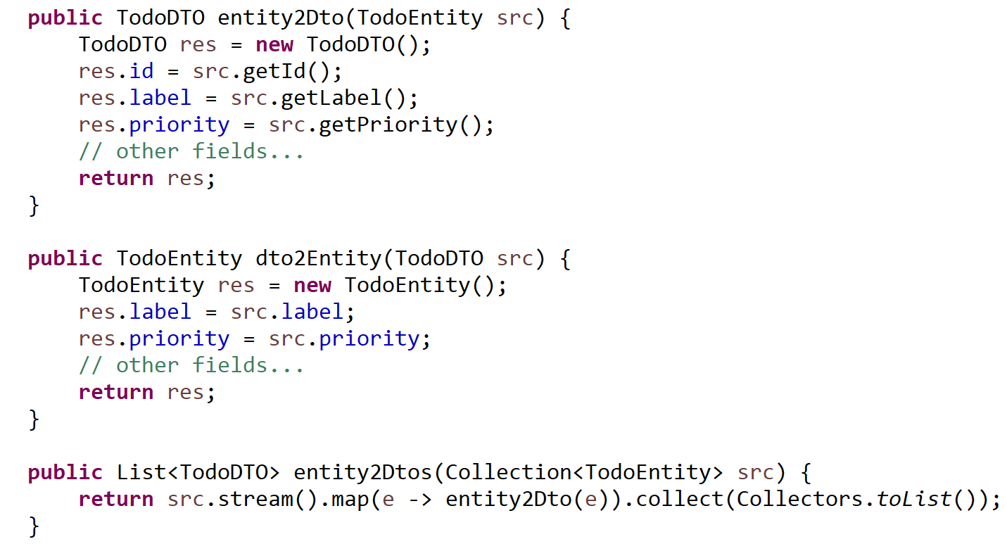
Typical CRUD Service (2/2) entity2Dto / dto2Entity

Slide 19
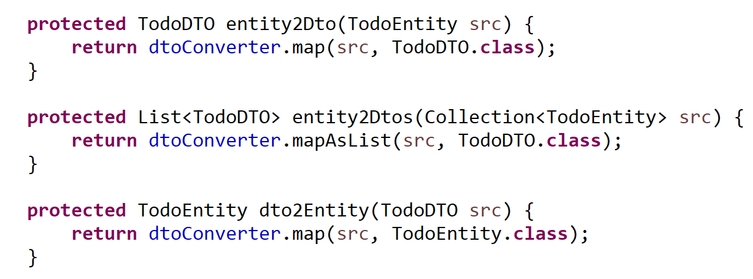
entity2Dto / dto2Entity using generic signature and « .class »

Slide 20
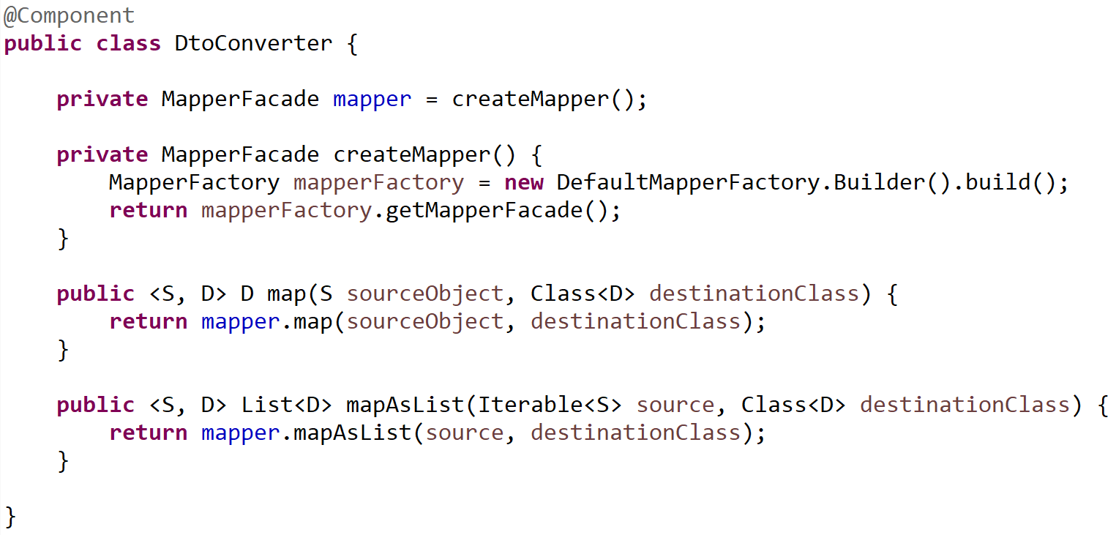
Using Orika MapperFacade

Slide 21
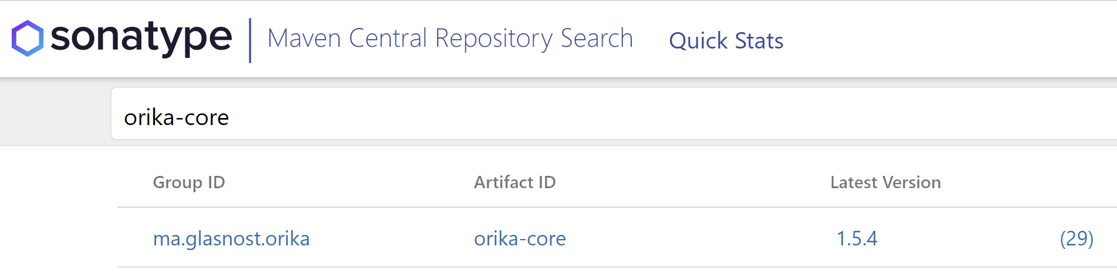
Orika
<dependency>
<groupId>ma.glasnost.orika</groupId>
<artifactId>orika-core</artifactId>
<version>${orika.version}</version>
</dependency>
https://search.maven.org/search?q=orika-core

Slide 22
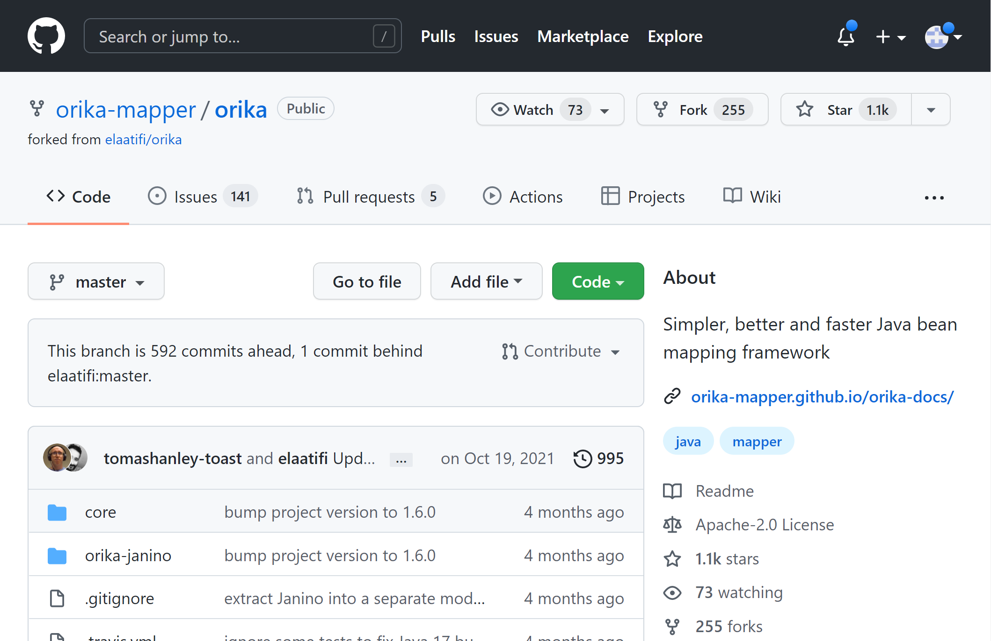
https://github.com/orika-mapper/orika

Slide 23
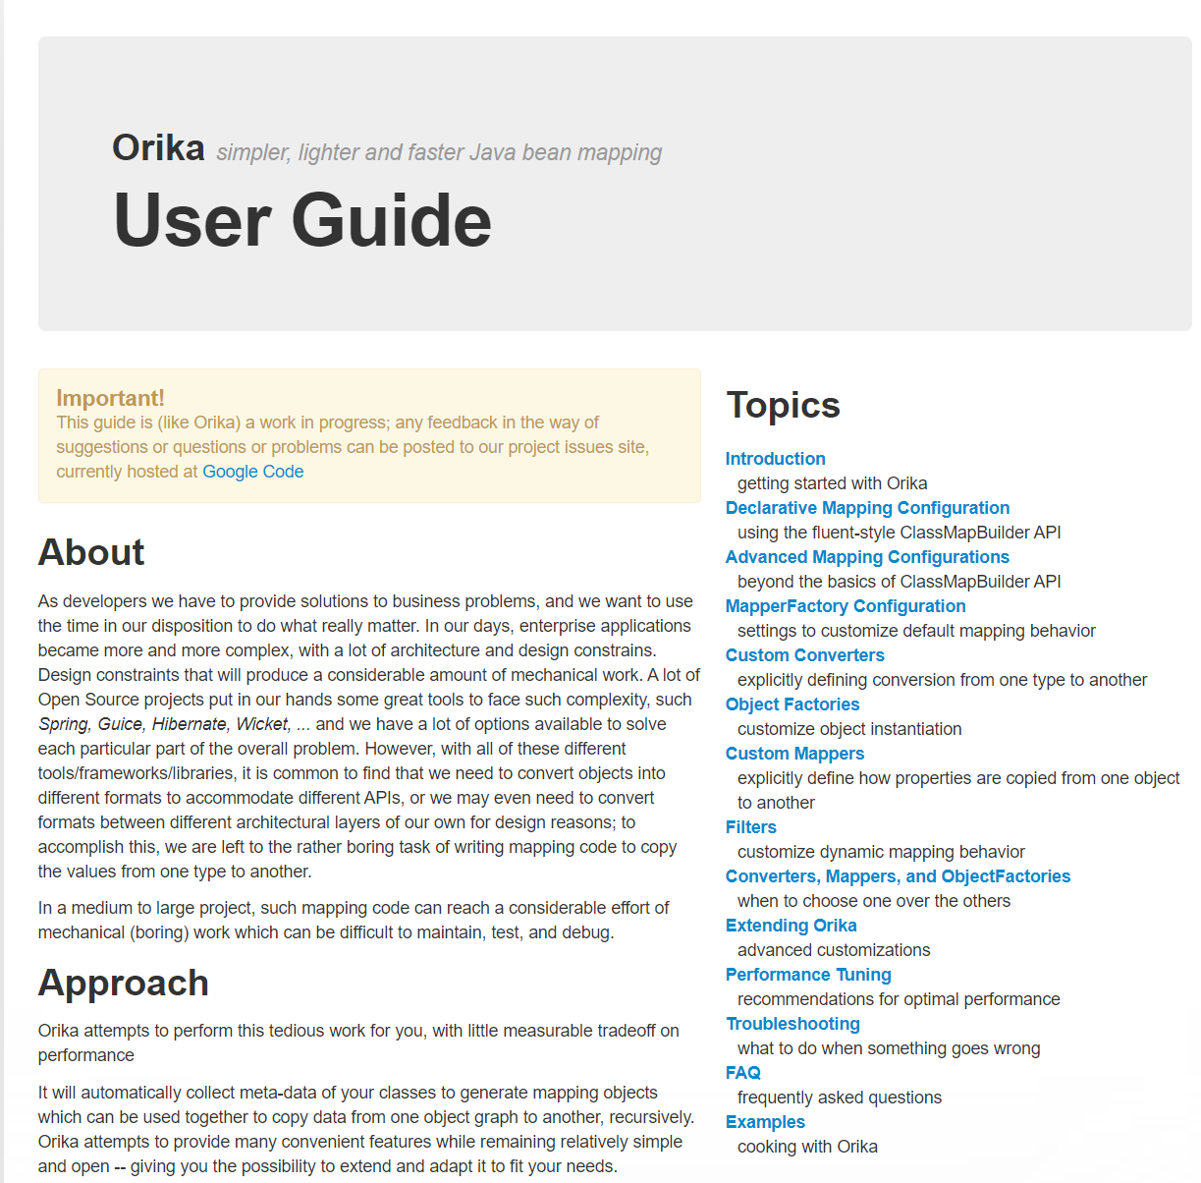
http://orika-mapper.github.io/orika-docs/

Slide 24
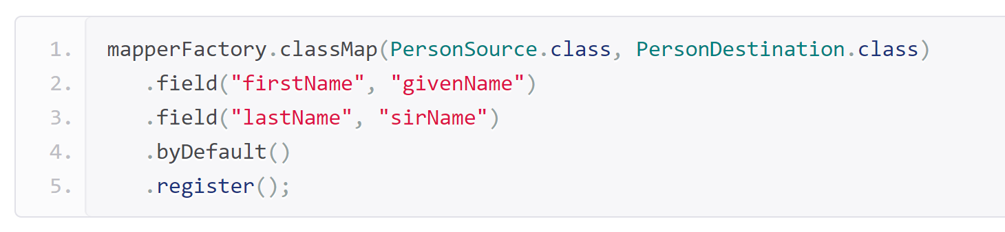
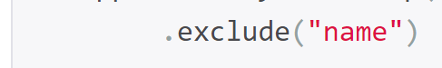

Orika Intro … customizing Class Mapper
Override custom
Bi-Directional field Mapping
= fieldAtoB + fieldBToA
Convention over configuration
Explicit Single-Directional
fieldAtoB != fieldBToA

Slide 25

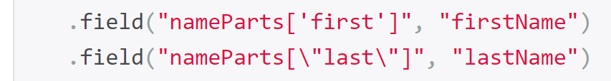
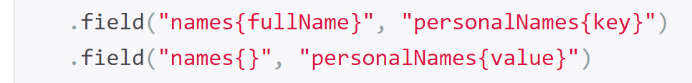
Customizing… mapping different structures
Nested field class <-> flat field
Default nested naming Convention !!!
« aaaBbb » <-> « aaa.bbb »
List<..> by index <-> flat field
Map<Key,..> <-> flat field
List<Nested field class> <-> Map<String,..>

Slide 26
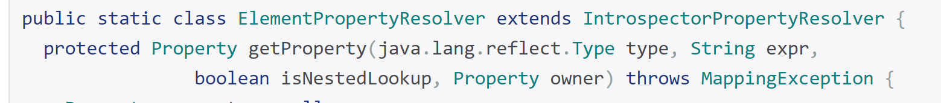
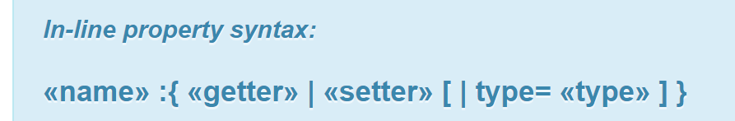
Customizing Properties Naming Conventions
Naming convention
for all Properties
Details
Naming convention
for 1 Property

Slide 27
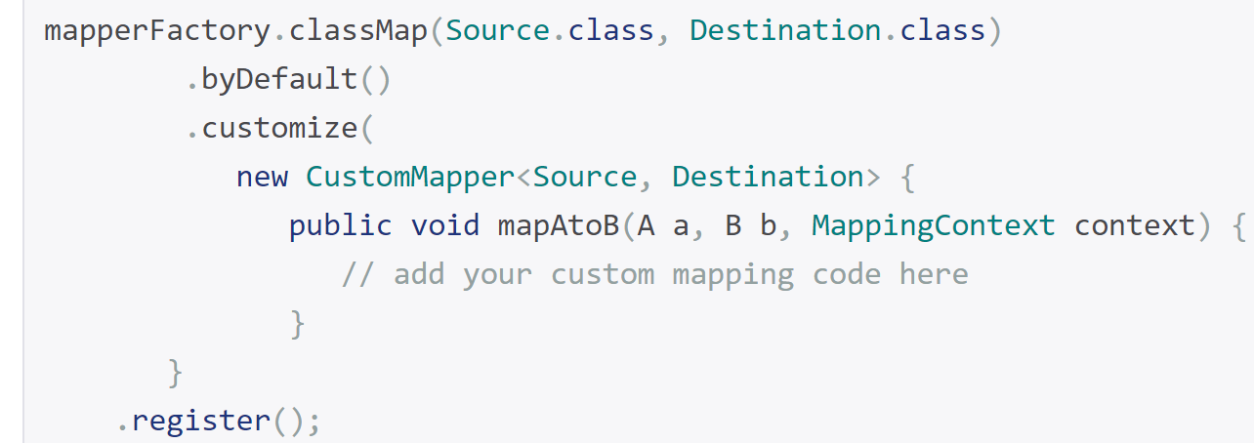
Customizer Mapper
override default Class to Class
Custom Mapper
(handle specific fields only)
Details
Class to Class Full
Custom Mapper
(handle all fields)

Slide 28
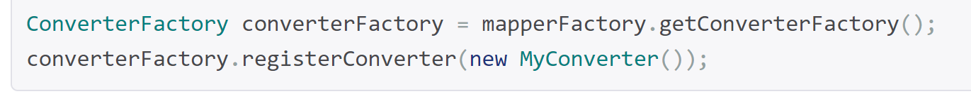
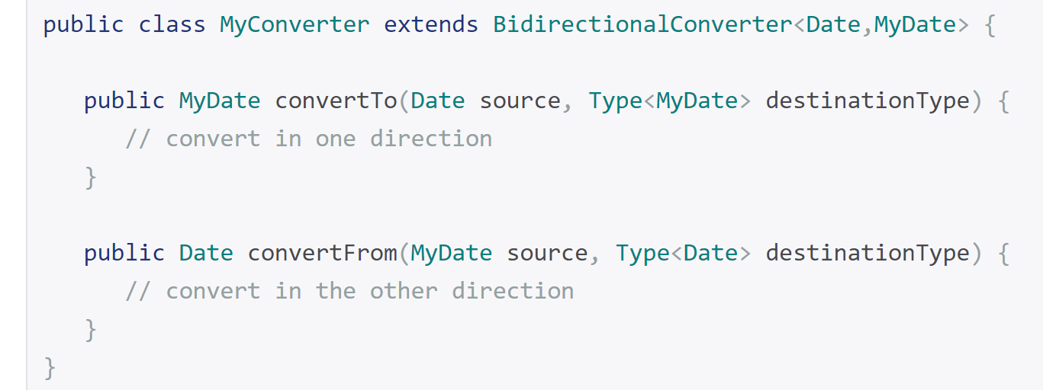
Custom Per Type Converter (apply to all type1<->type2 properties)
Details

Slide 29
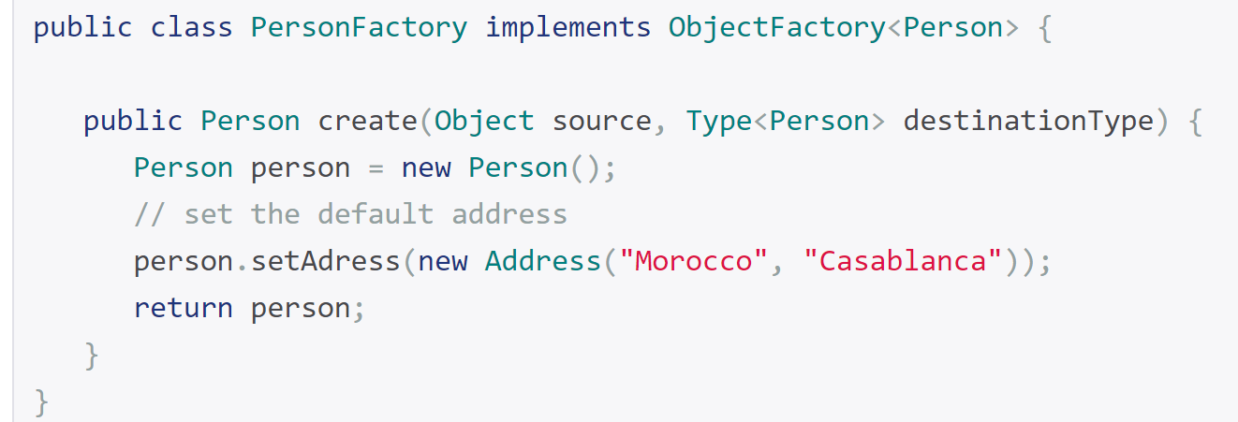
Custom « new » Object Factory
Details

Slide 30
More customizations … Filter
customize dynamic mapping behavior
Details

Slide 31
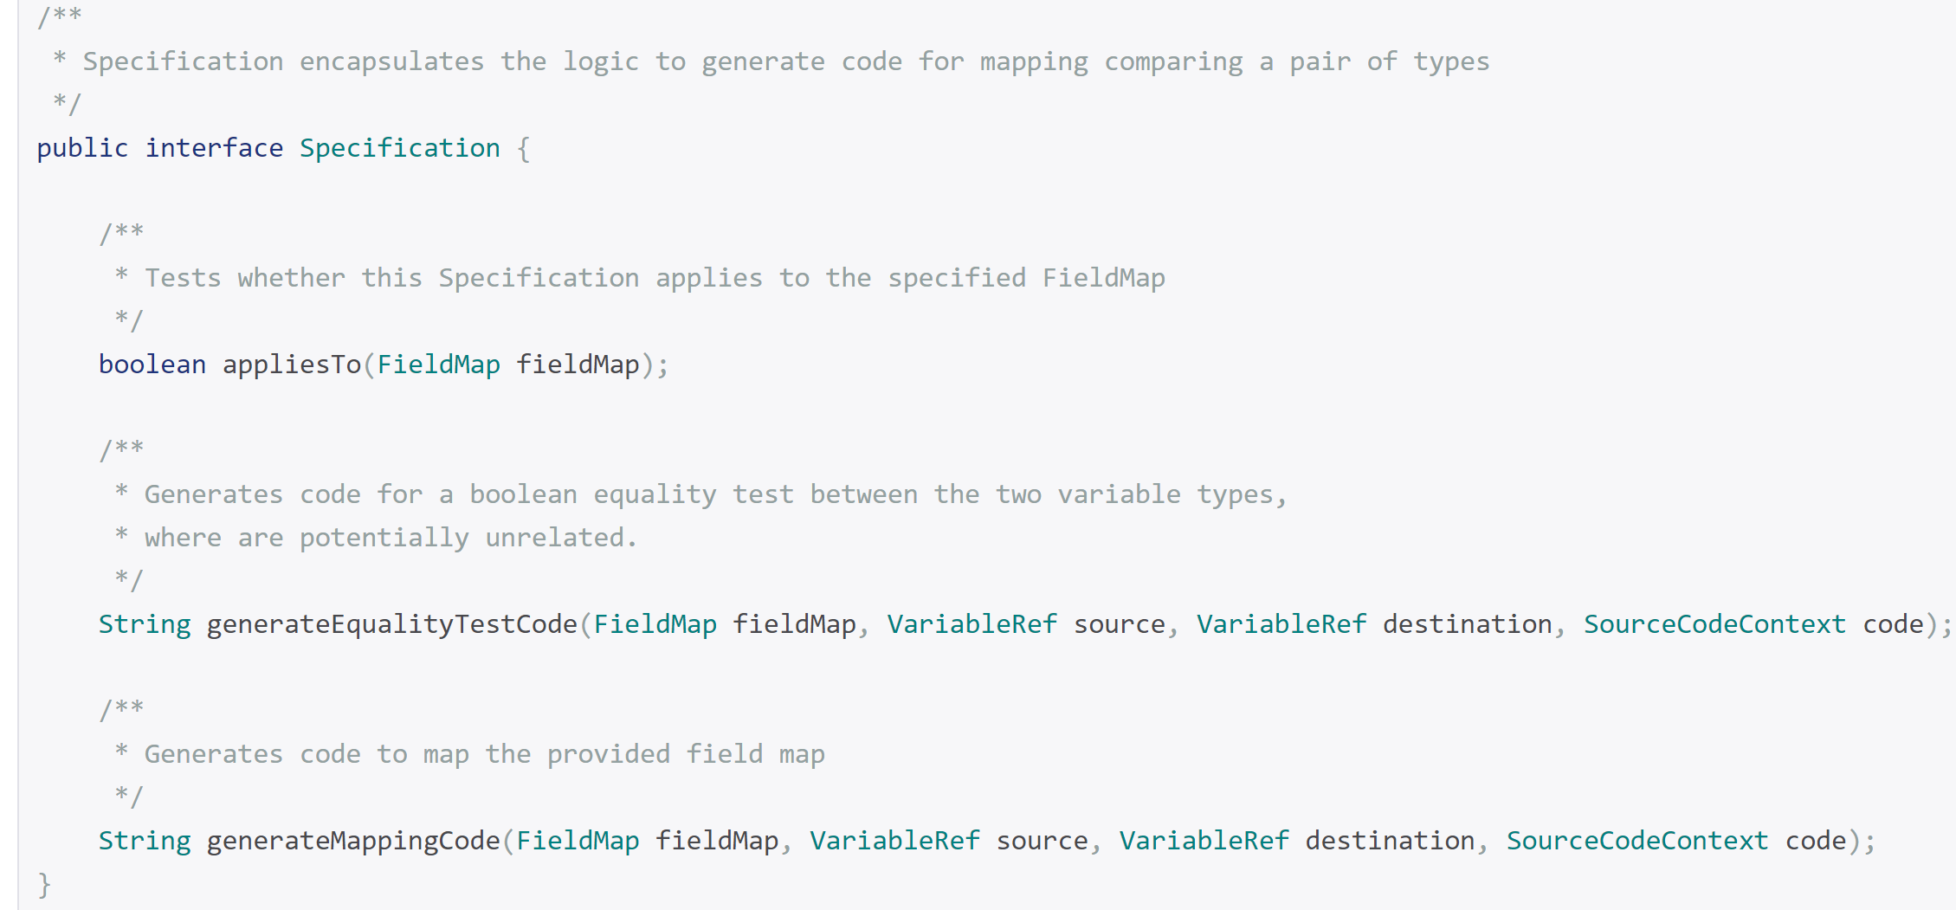
Code Generator Options
Details

Slide 32
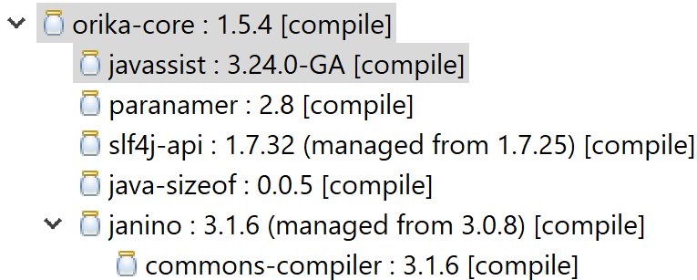
Code Generated ??? YES !!!
DEFAULT: javaassist
ma.glasnost.orika.impl.generator.JavassistCompilerStrategy
ma.glasnost.orika.impl.generator.JaninoCompilerStrategy
strategy
Janino
(also in logback)
Opaque « .class » bytecode …
Default NO generated/debuggable « .java » Source
EclipseJdt
ma.glasnost.orika.impl.generator.EclipseJdtCompilerStrategy
add
<dependency>
<groupId>ma.glasnost.orika</groupId>
<artifactId>orika-eclipse-tools</artifactId>
<version>${orika.version}</version>
</dependency>
Debuggable
« .class » bytecode + generated « .java » Source-Code with Line numbers

Slide 33
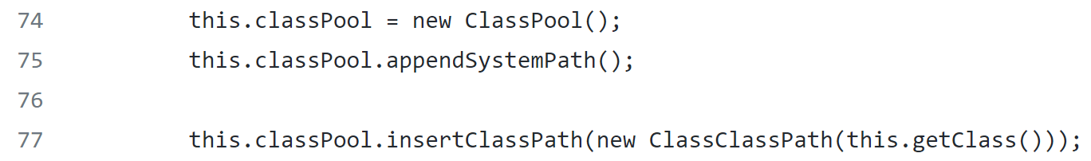
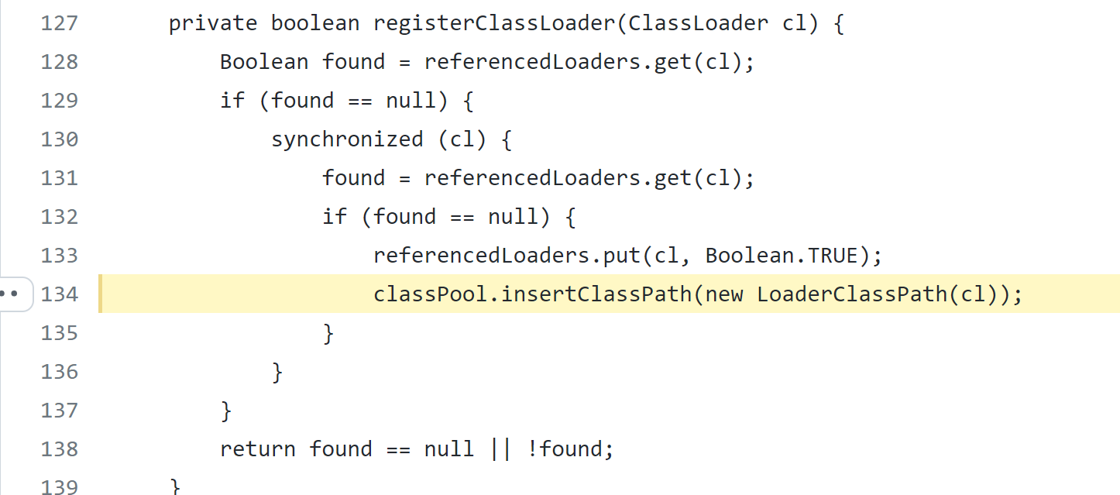
Javaassist + register ClassPool in ClassLoader
https://github.com/orika-mapper/orika/blob/master/ core/src/main/java/ma/glasnost/orika/impl/generator/JavassistCompilerStrategy.java#L134

Slide 34
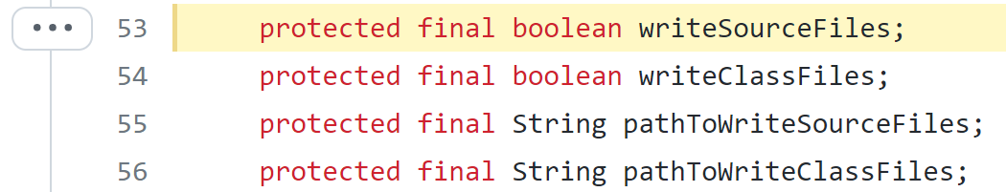
Writing Generated Classes..
https://github.com/orika-mapper/orika/blob/master/ core/src/main/java/ma/glasnost/orika/impl/generator/CompilerStrategy.java#L53
Using System.properties
ma.glasnost.orika.writeSourceFiles
ma.glasnost.orika.writeClassFiles
ma.glasnost.orika.writeSourceFilesToPath
ma.glasnost.orika.writeClassFilesToPath

Slide 35
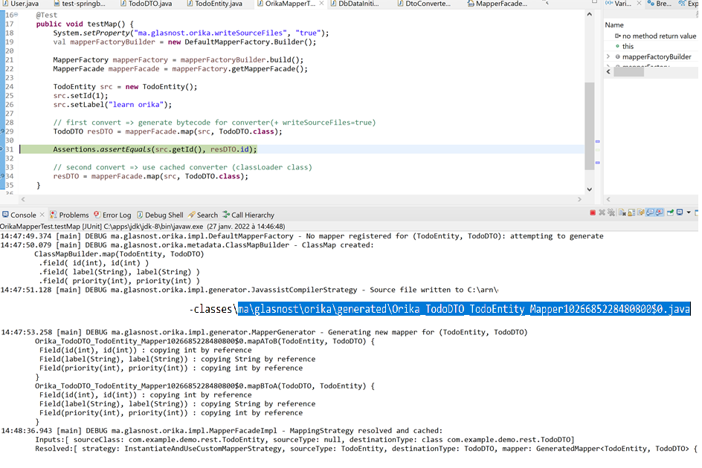
First call map() => generating Mapper for (ClassA,ClassB)

Slide 36
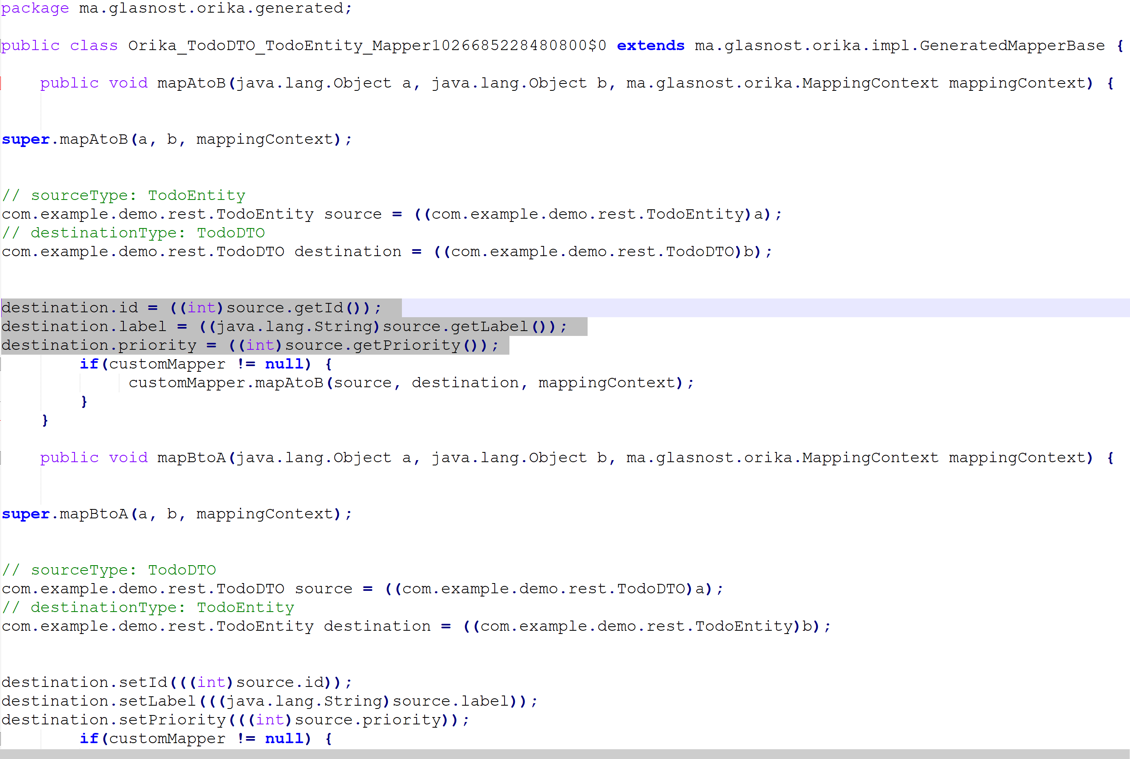
Generated code.. (file not visible in Eclipse?)
Optimal compiled code
Entity -> DTO
(with extra cast)
Optimal compiled code
DTO -> Entity
(with extra cast)

Slide 37
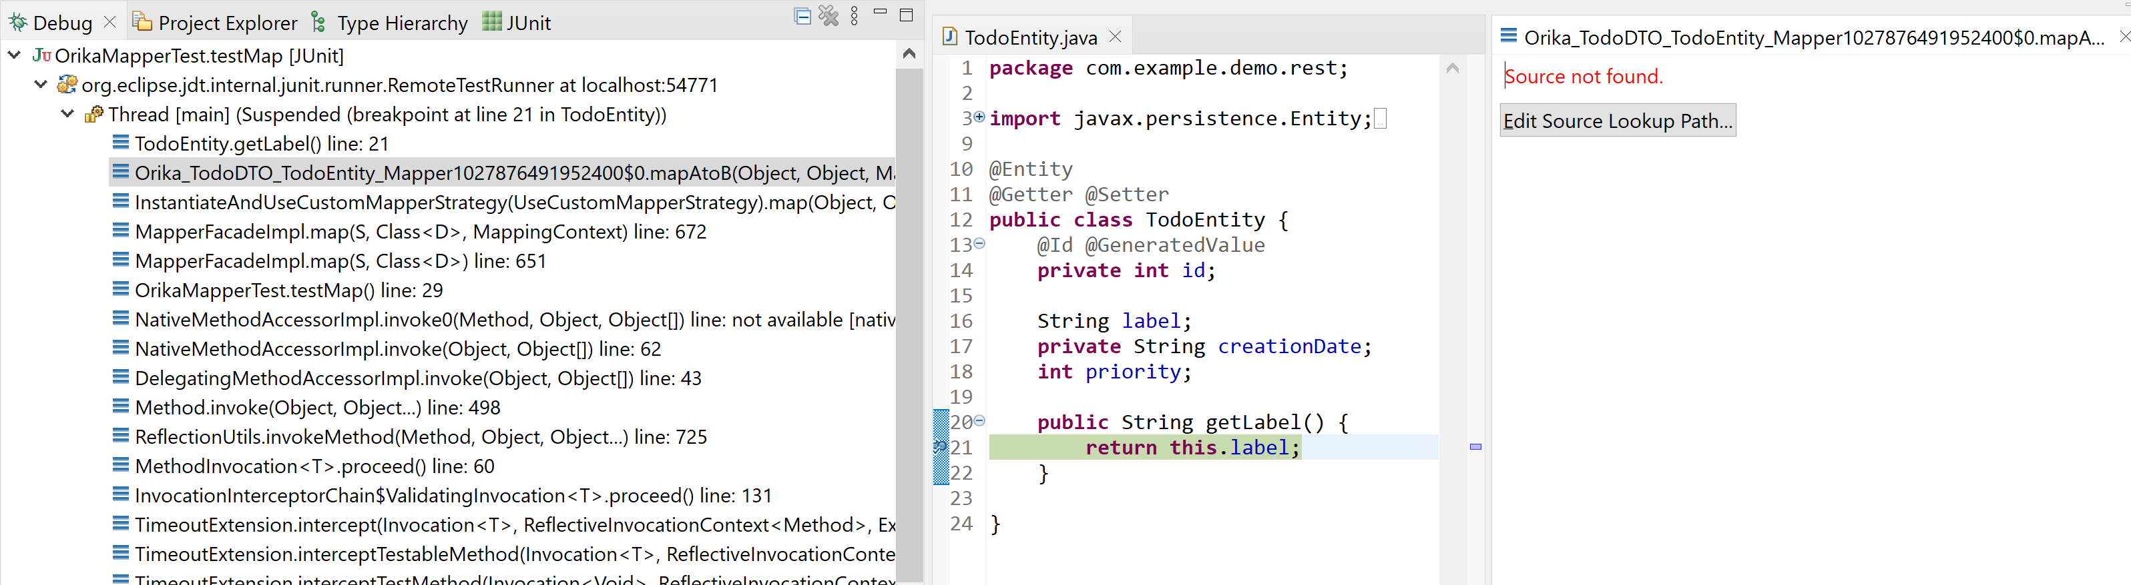
Generated Code .. Source not visible in Eclipse

Slide 38
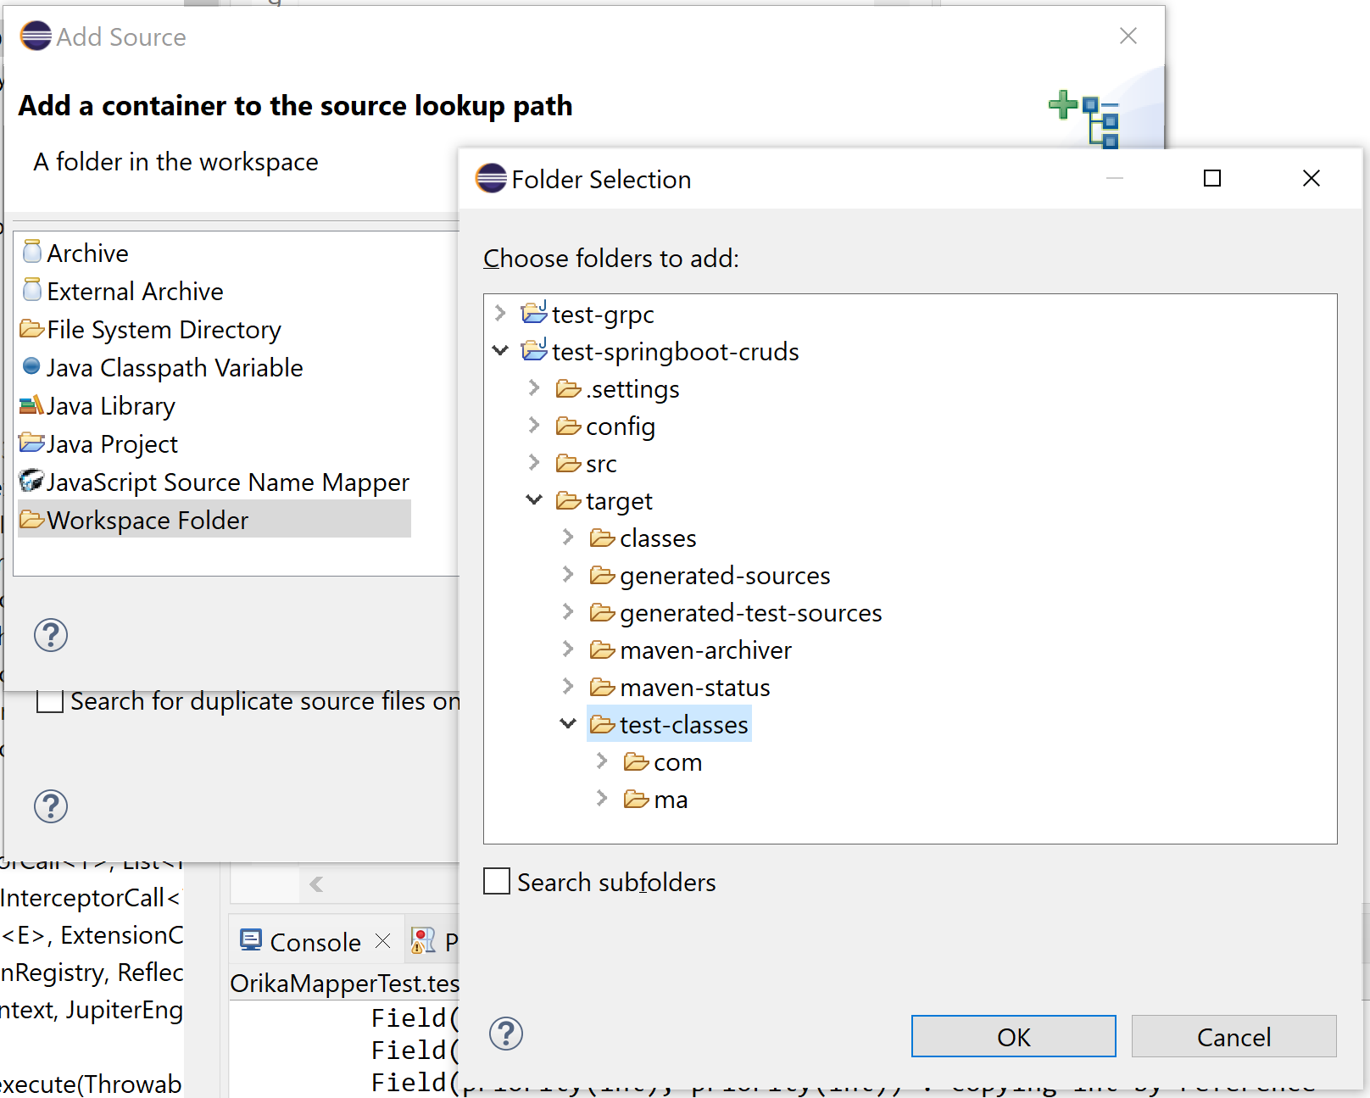
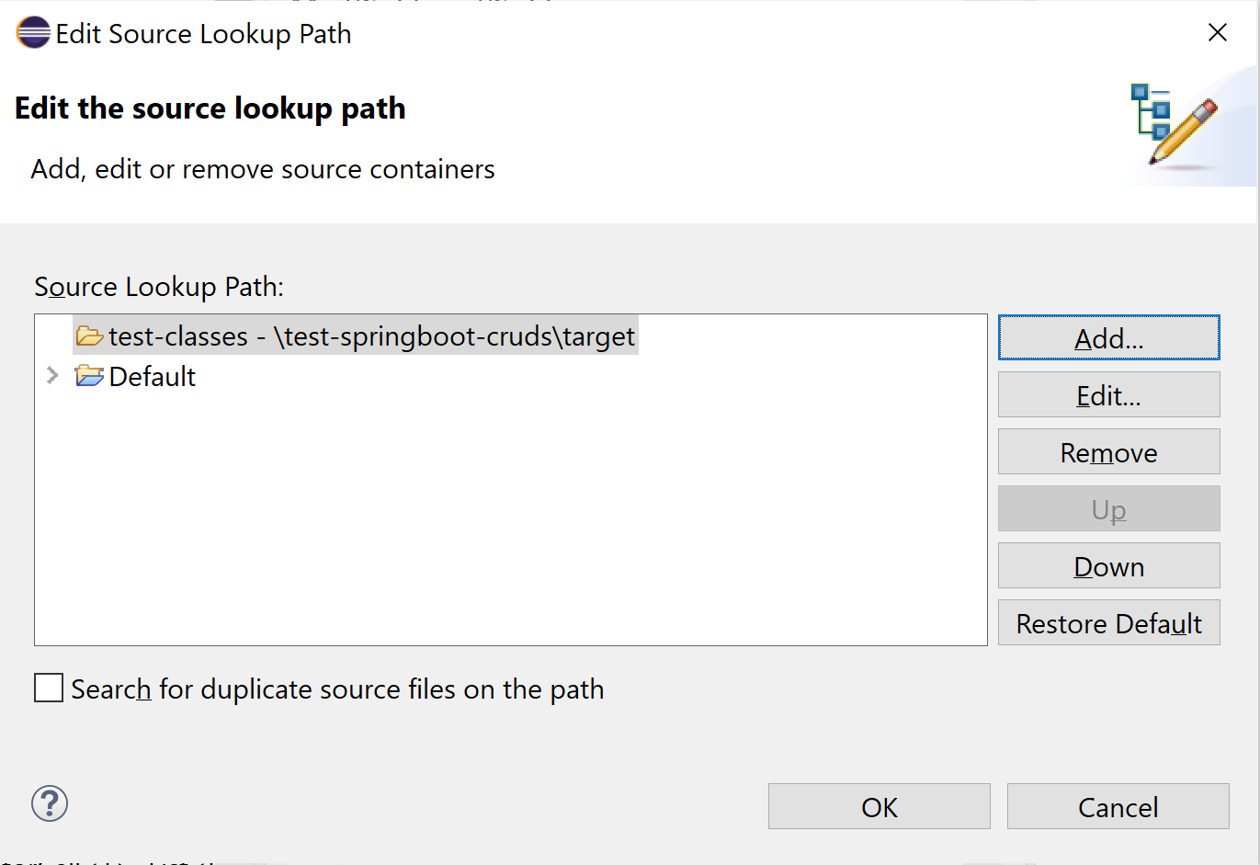
Adding Source

Slide 39
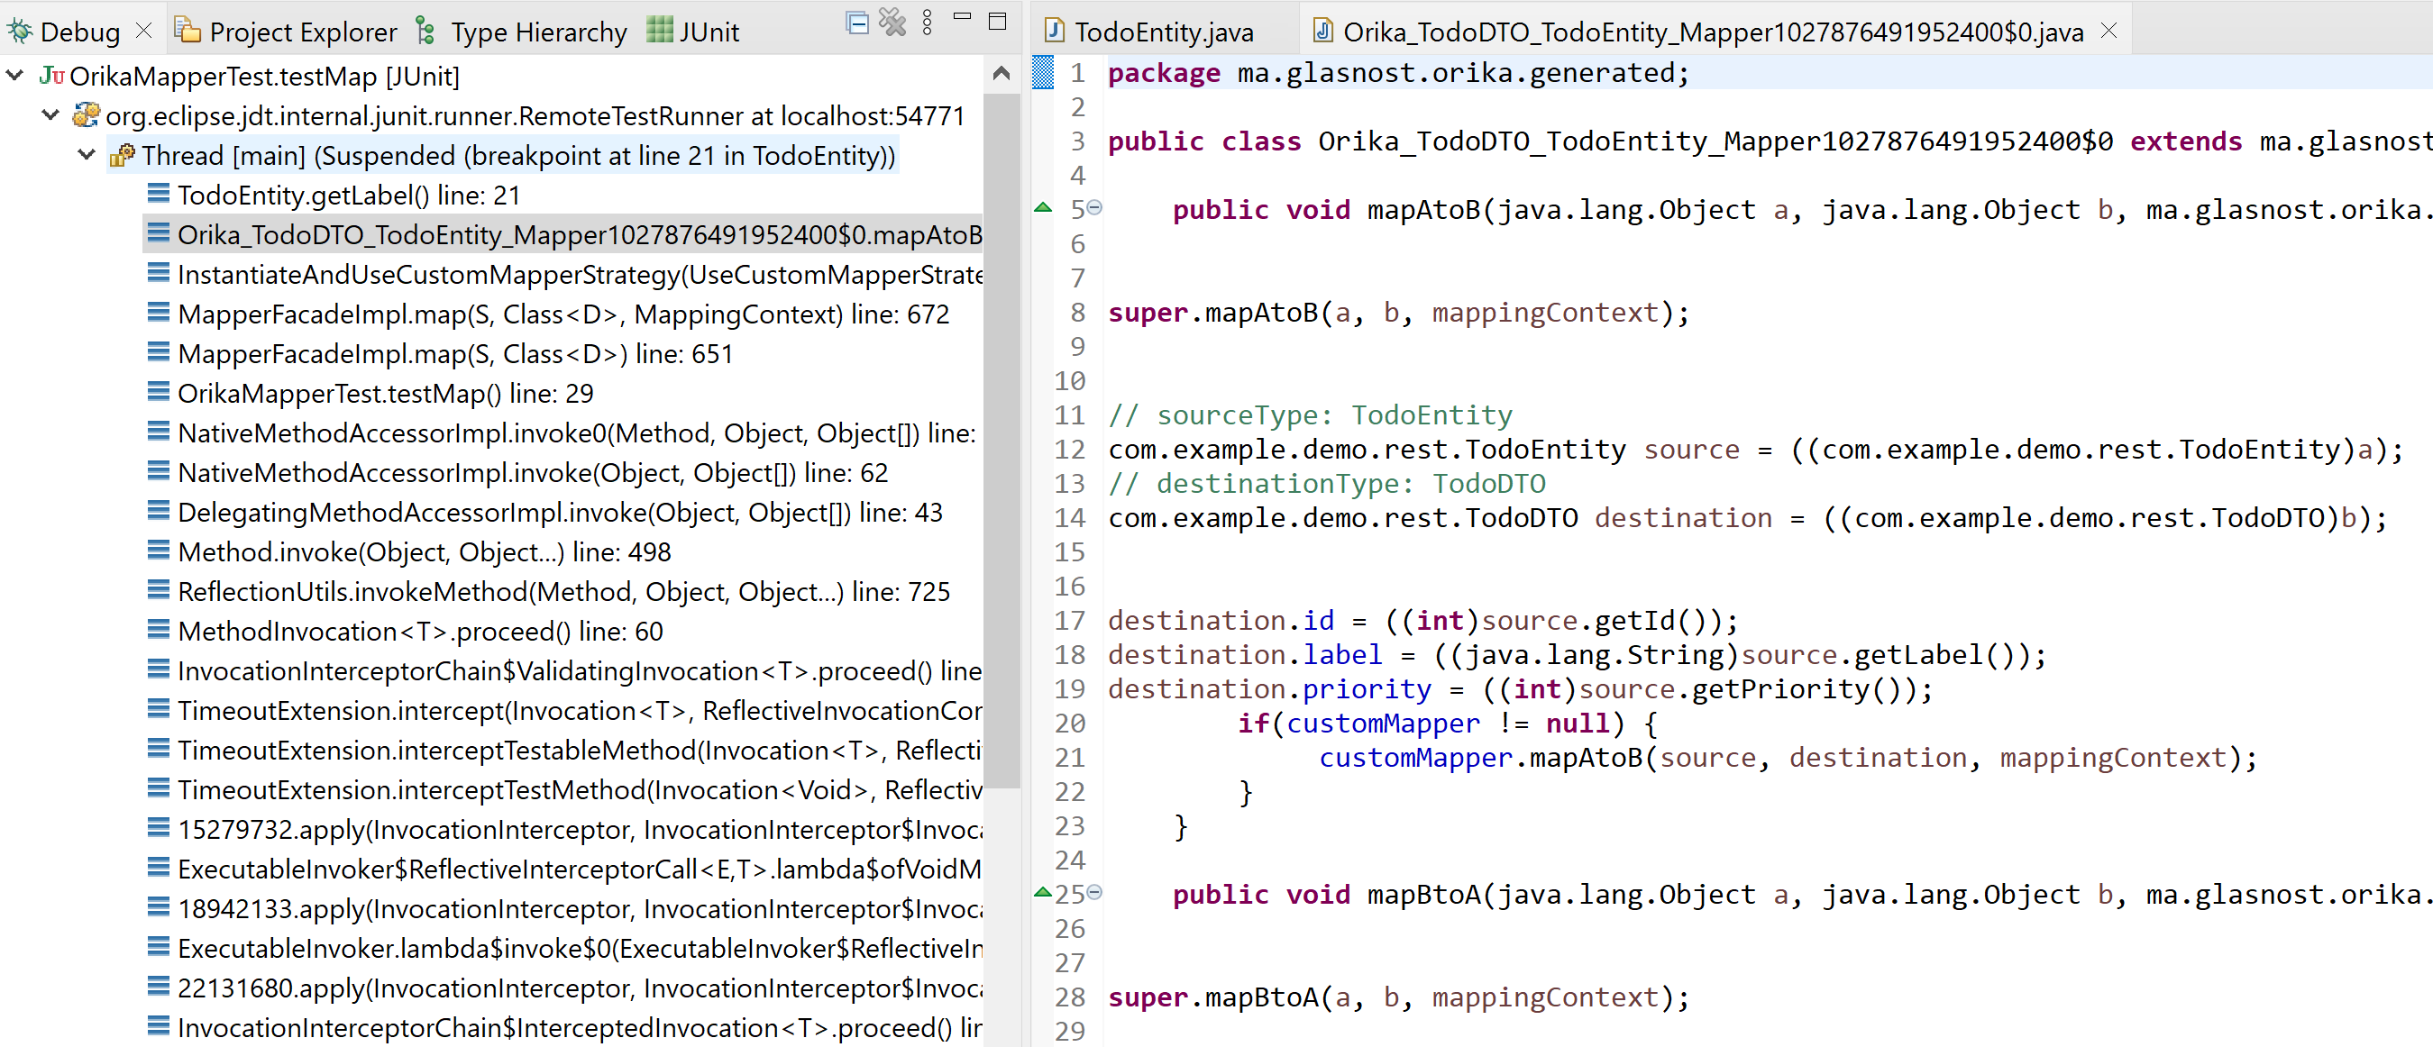
Debugging « Line Number » info not available! ( mode javaassist … switch to mode EclipseJdt )
Supposed to be here
« .getLabel() »
Line 18 … ??

Slide 40
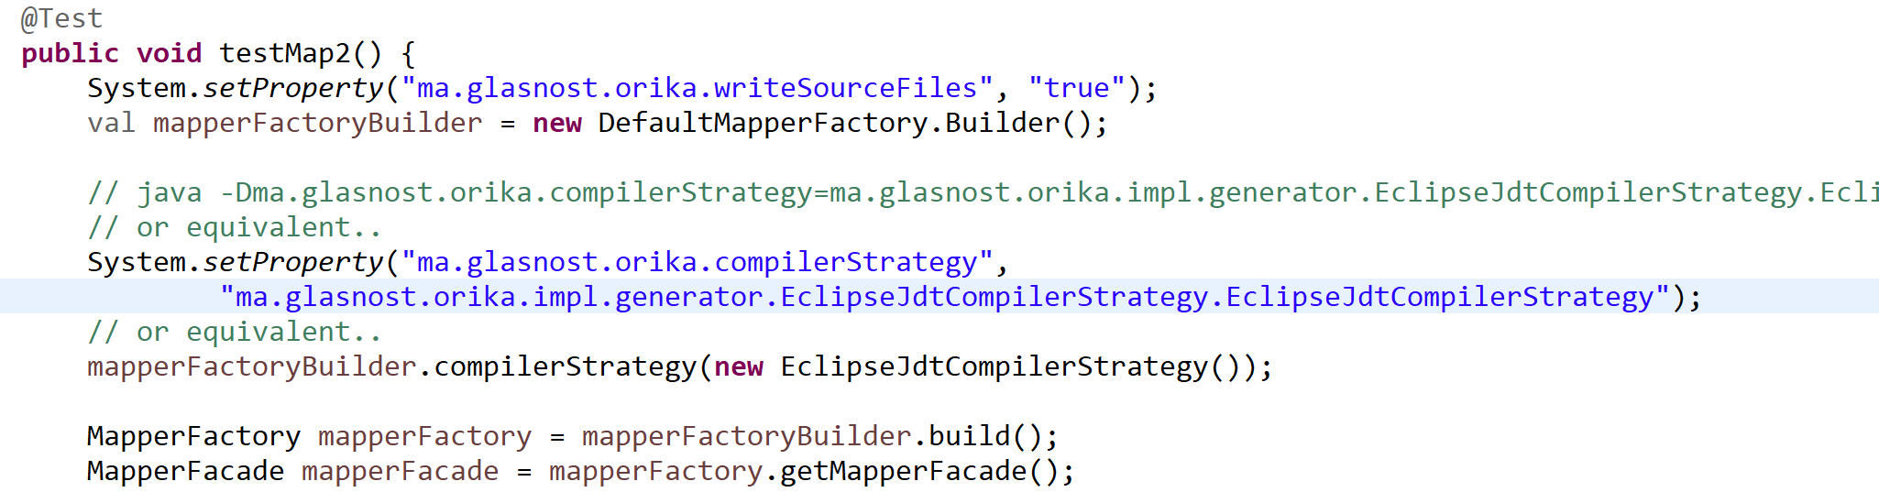
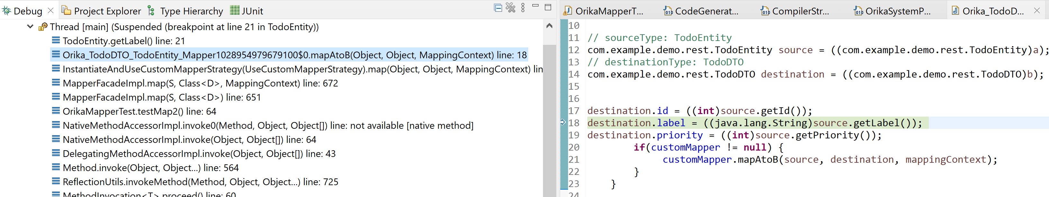
Activating EclipseJdtCompilerStrategy

Slide 41
Orika = the « Simpler, faster and better Java bean mapping framework»
1/ Ultra FAST (as fast as optimized hand-written code)
2/ Ultra concise API … convention of configuration
3/ fully customizable if needed
4/ No need to configure compile-time code generator / IDE plugins
5/ can still see generated code in IDE, on demand
-- NO built-in recognized support for findById() « id » <-> « entity » in JPA + springboot
NOT suitable for JPA « merge » / need business logic code

Slide 42
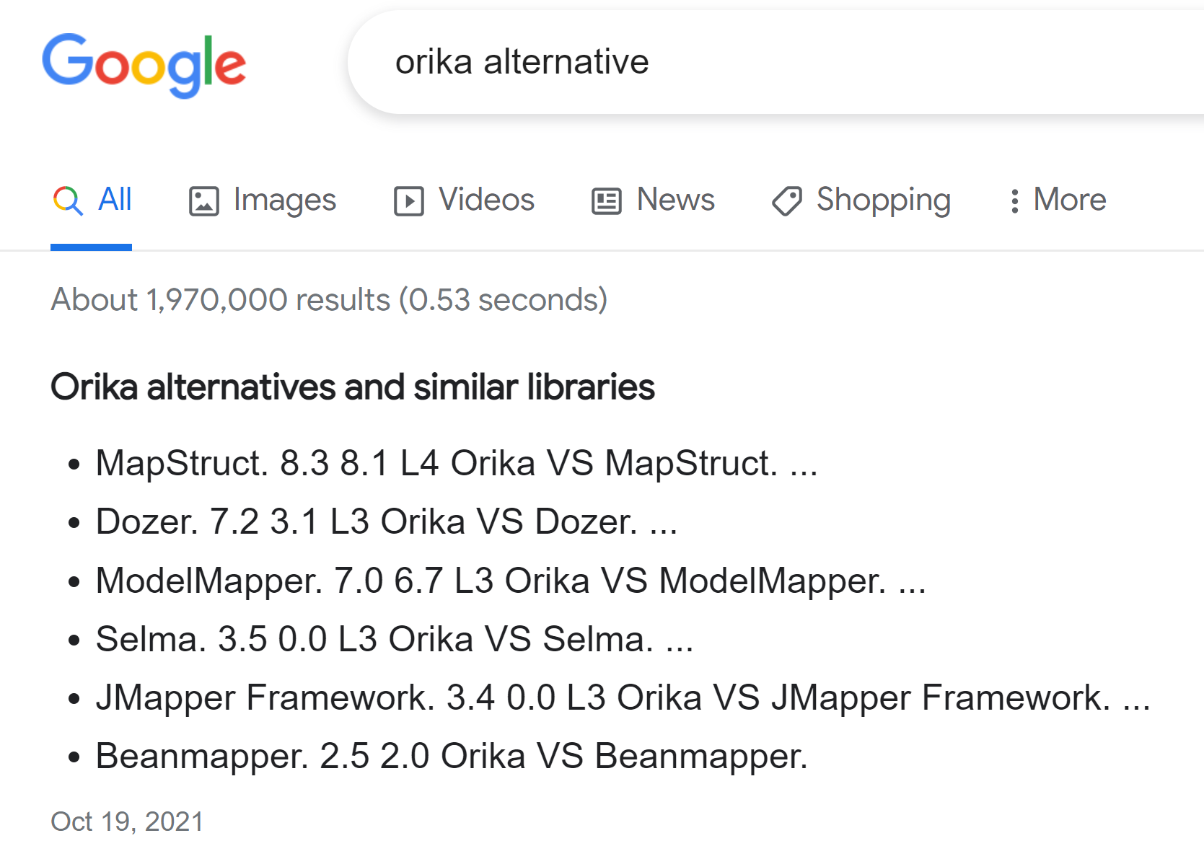
Orika Alternatives
« MapStruct » chosen in JHipster
++ code generated at compile-time
-- … need IDE plugins / config
-- need to declare all methods signatures in interfaces
Non viable legacy ideas
« Dozer » !!
Old, buggy, NO code generated
Very bad performances
Fully by introspection

Slide 43
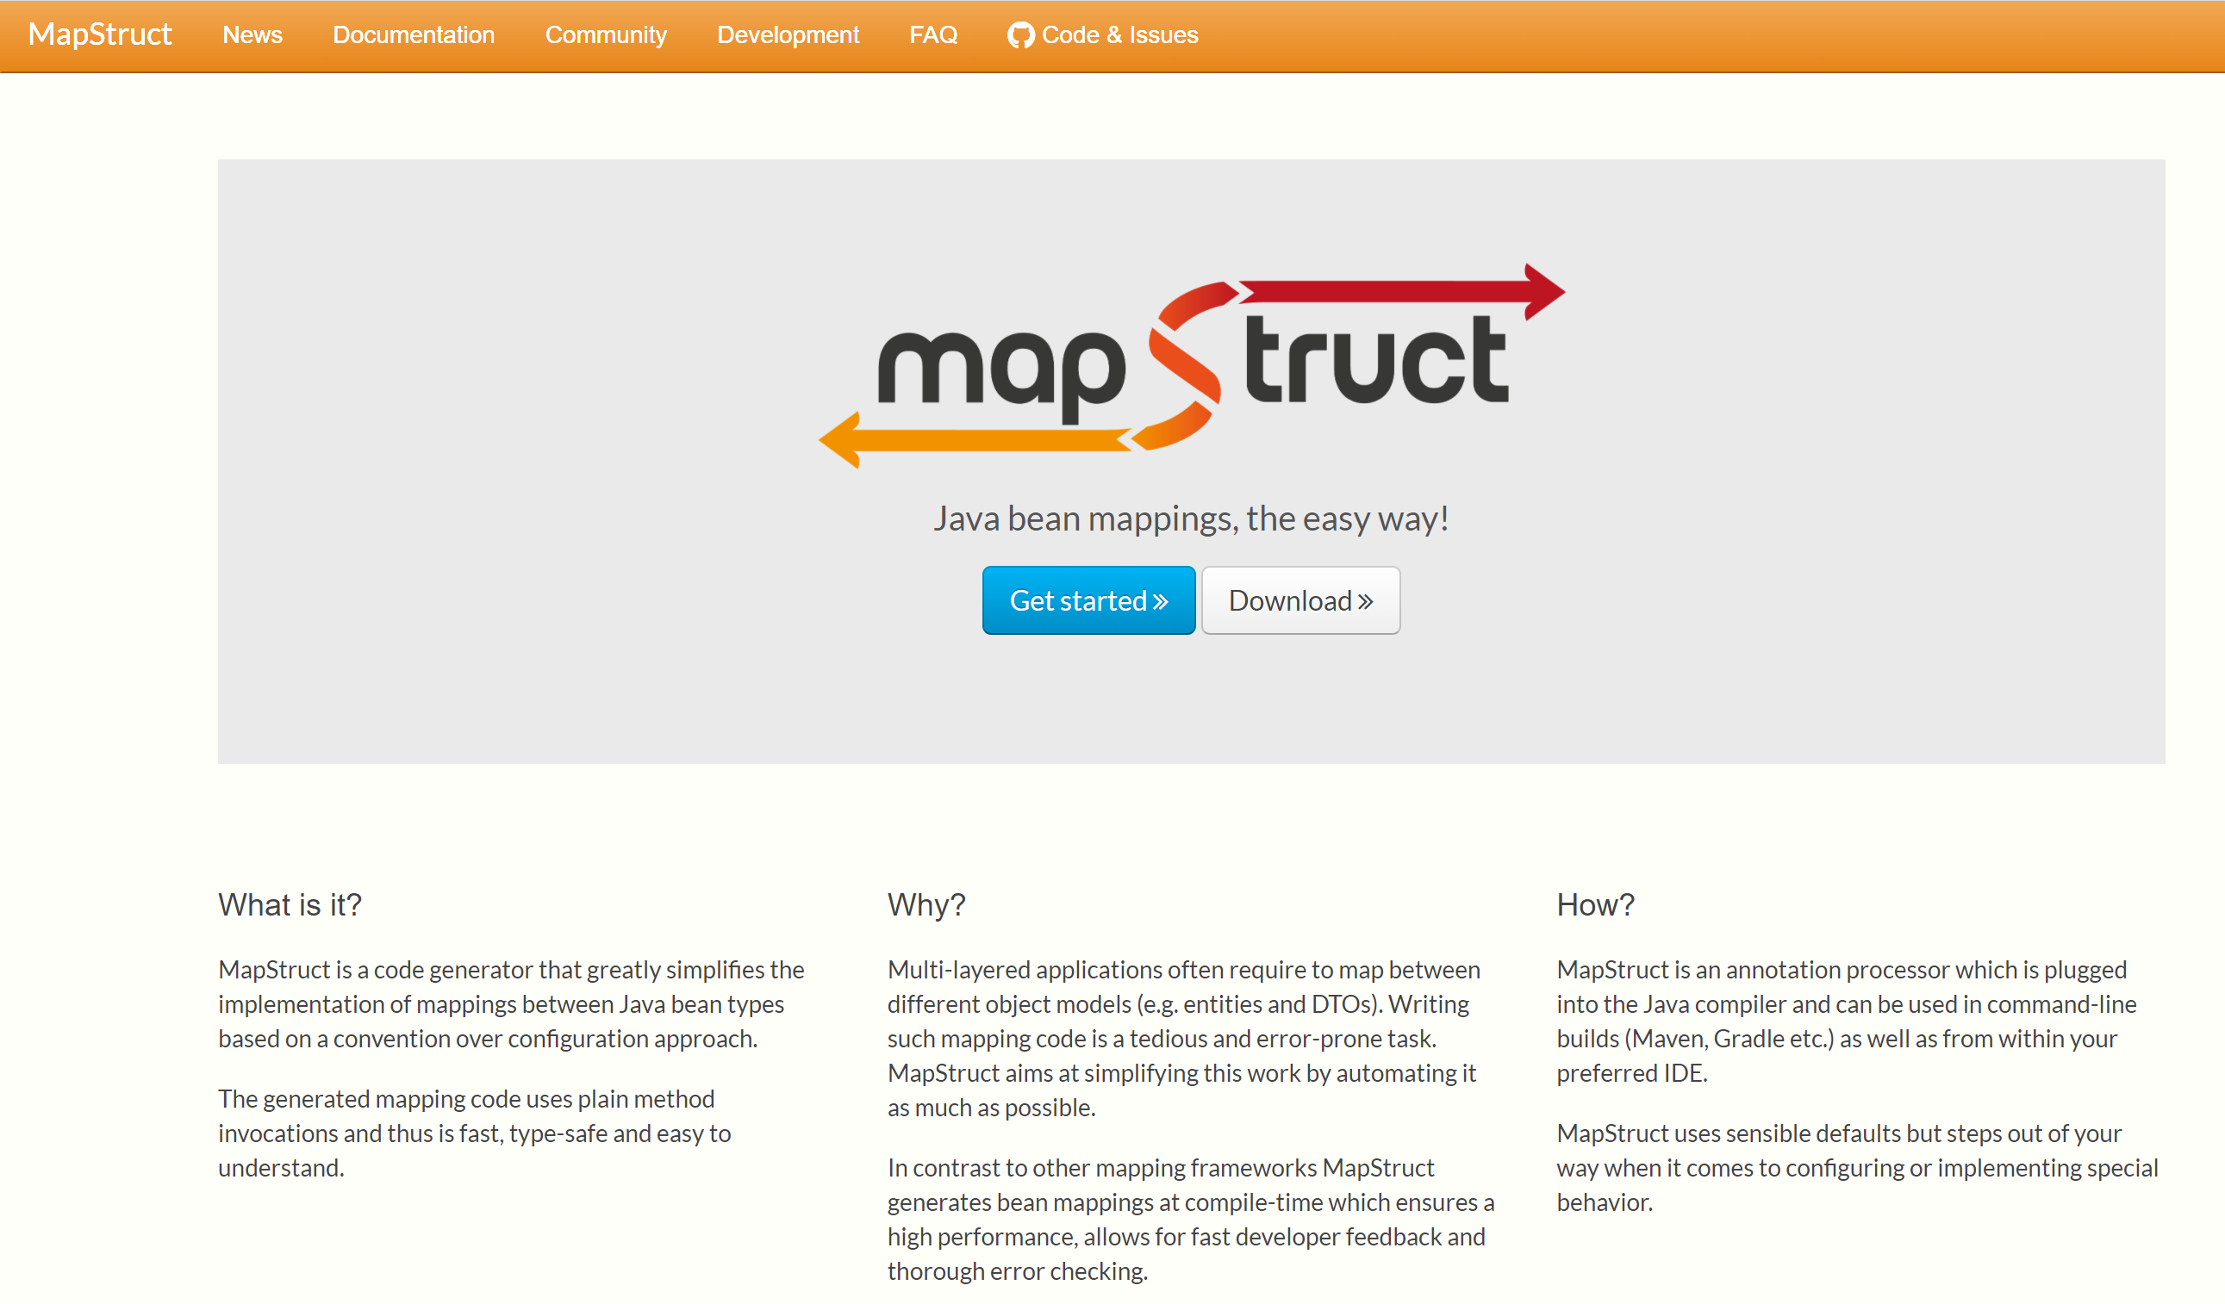
MapStruct (alternative chosen in Jhipster )
https://mapstruct.org/

Slide 44
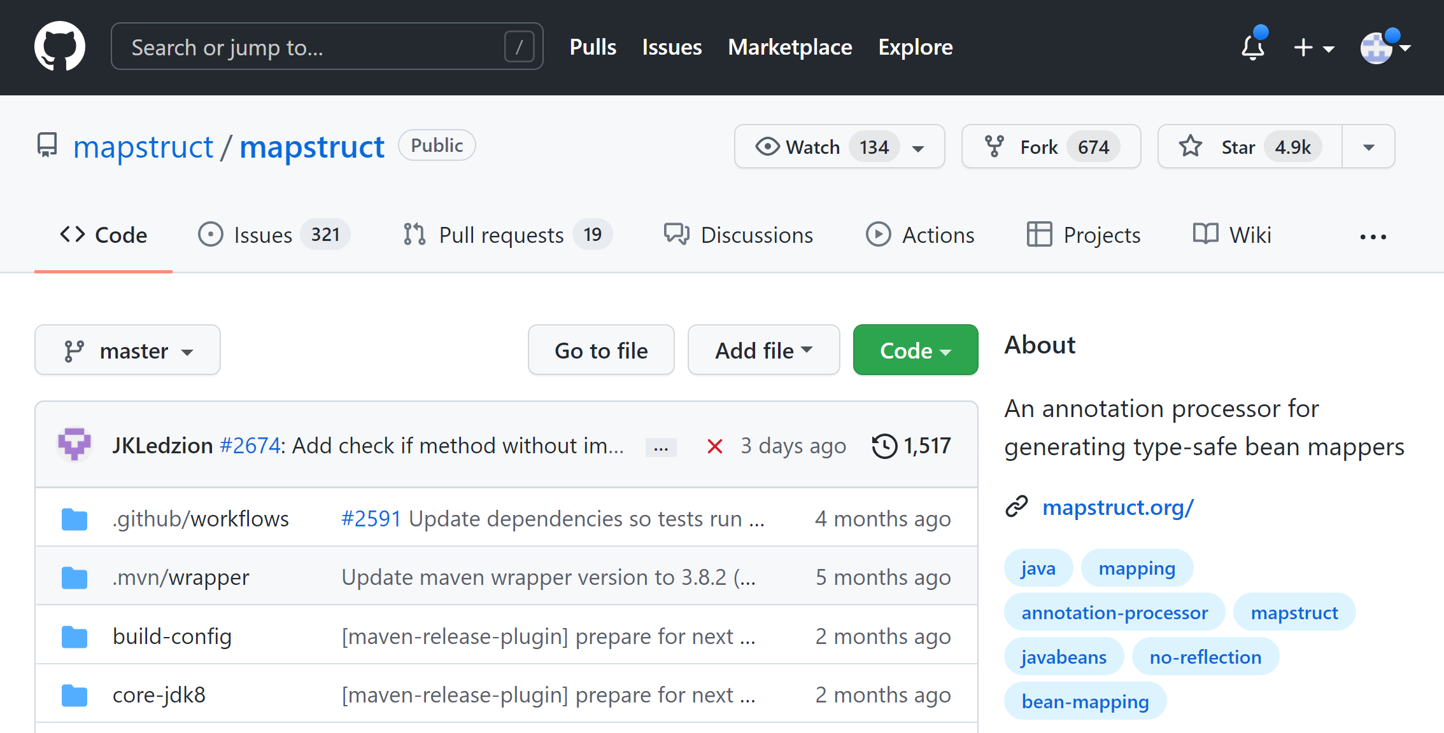
https://github.com/mapstruct/mapstruct

Slide 45
Orika … no findById in Springboot/JPA ?
-- NO built-in recognized support for findById() « id » <-> « entity » in JPA + springboot
NOT suitable for JPA « merge » / need business logic code

Slide 46
Mapping Entity-DTO + Entity – ID findById !!
XEntity
entityToDTOId
XDTO
@ManyToOne( fetchType=LAZY)
0..1
0..1
YEntity
YLightIdDTO
YDetailedDTO
Update XEntity
… do not put invalid empty object in session !!
do not « clean » existing YEntity content !!
do not create new empty YEntity !!
« attach » / « detach » existing Entity by ids
dtoIdToEntity
Edit on Client-side …
- change some fields ( no change ManyToOne )
- Change ManyToOne relation

Slide 47
Reminder findById() … unique Object in Session per Id
Level1Cache
(=Session )
Read-Write, single-thread
Level2Cache
(=Global)
Read-Only, multi-threads
Thread
XA (Transaction)
a.getB()
lookup in Level2Cache
Perform jdbc « select … where id=? »
If ! already
lazy fetched
b = brepo.findById(id)
Clone read-only cached to (read-write) Entity
Fill Entity from Jdbc
+ put in cache
Lookup in Level2Cache
If found => return pointer

Slide 48
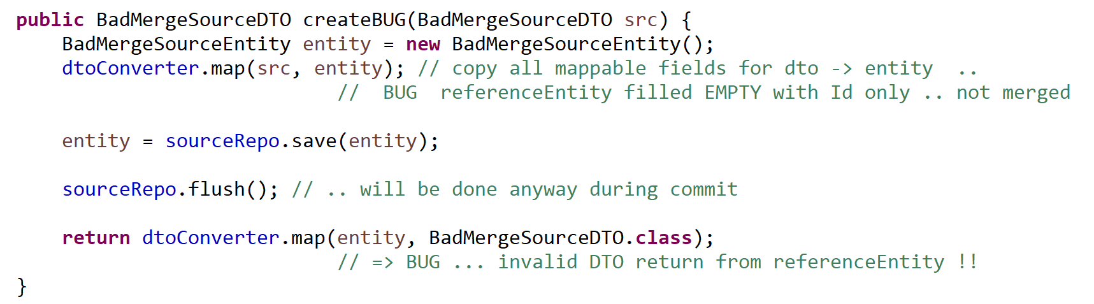
Buggy code.. « new Entity(id) + mapper (un-customized) »

Slide 49
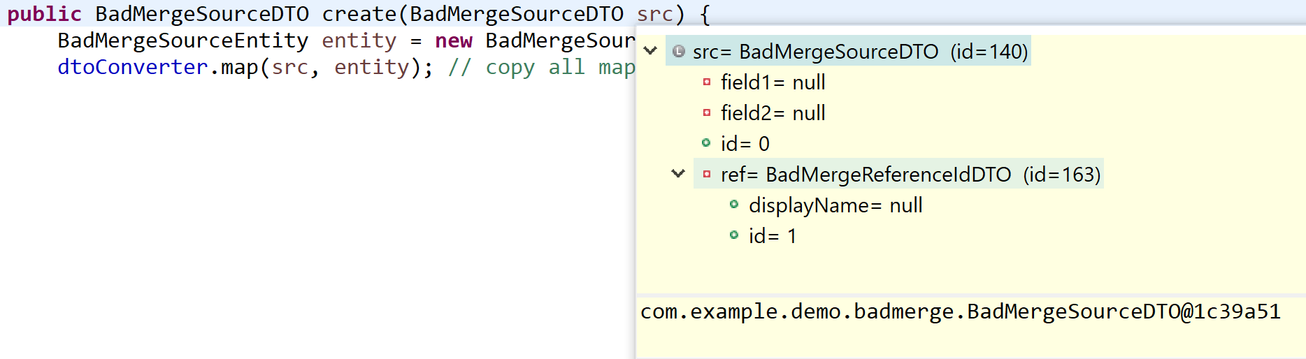
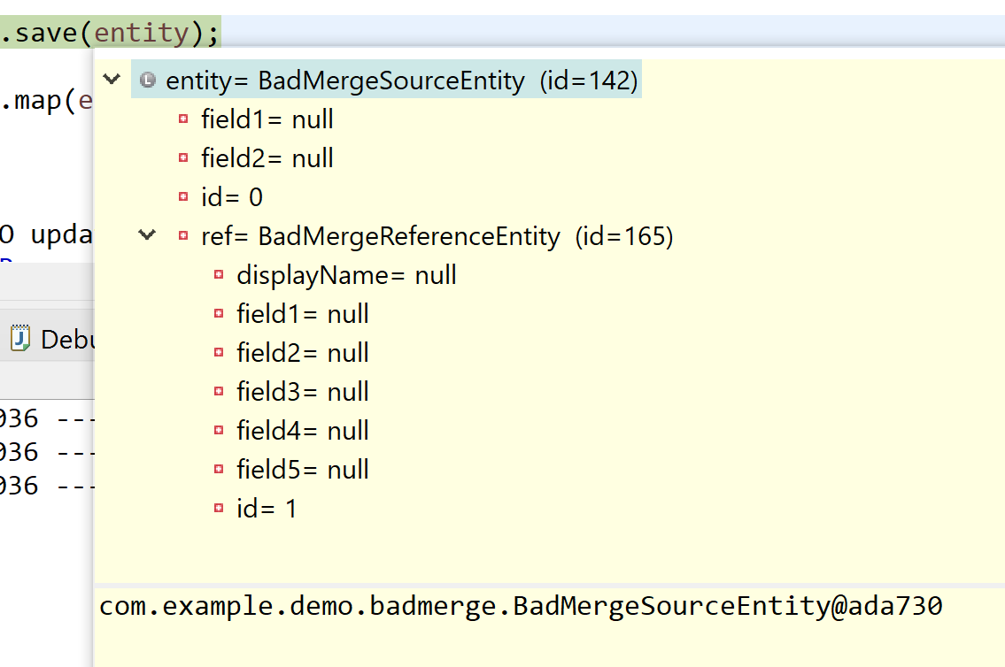
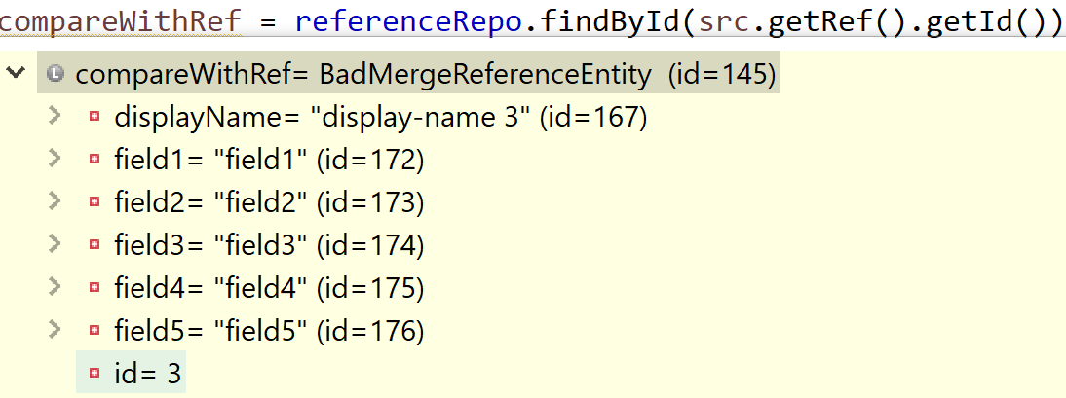
do NOT use « new Entity(id) + mapper (un-customized) » need JPA merge? … use JPA findById() !!
Detached
(invalid) entity

Slide 50
… BUG return invalid after entity2dto …
DTO from « detached entity »
… invalid (not merged ) => put in session instead of real entity
But value in DB is OK …

Slide 51
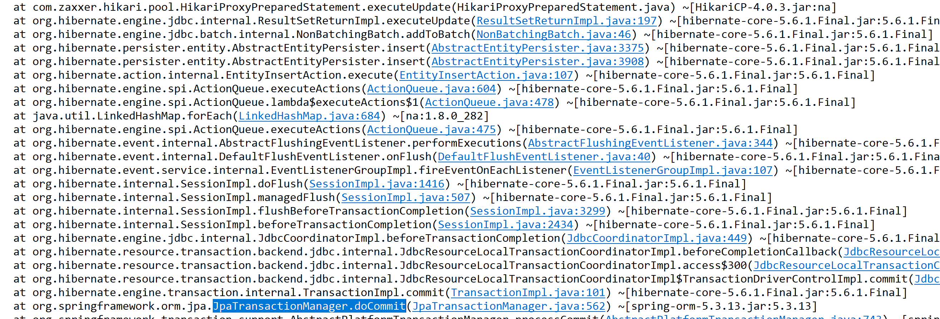
Sending invalid « id » not in DB … 500 (in commit) instead of 400 (find in user code)
http 500 … failed on « server-side » … should be http 400: bad client input

Slide 52
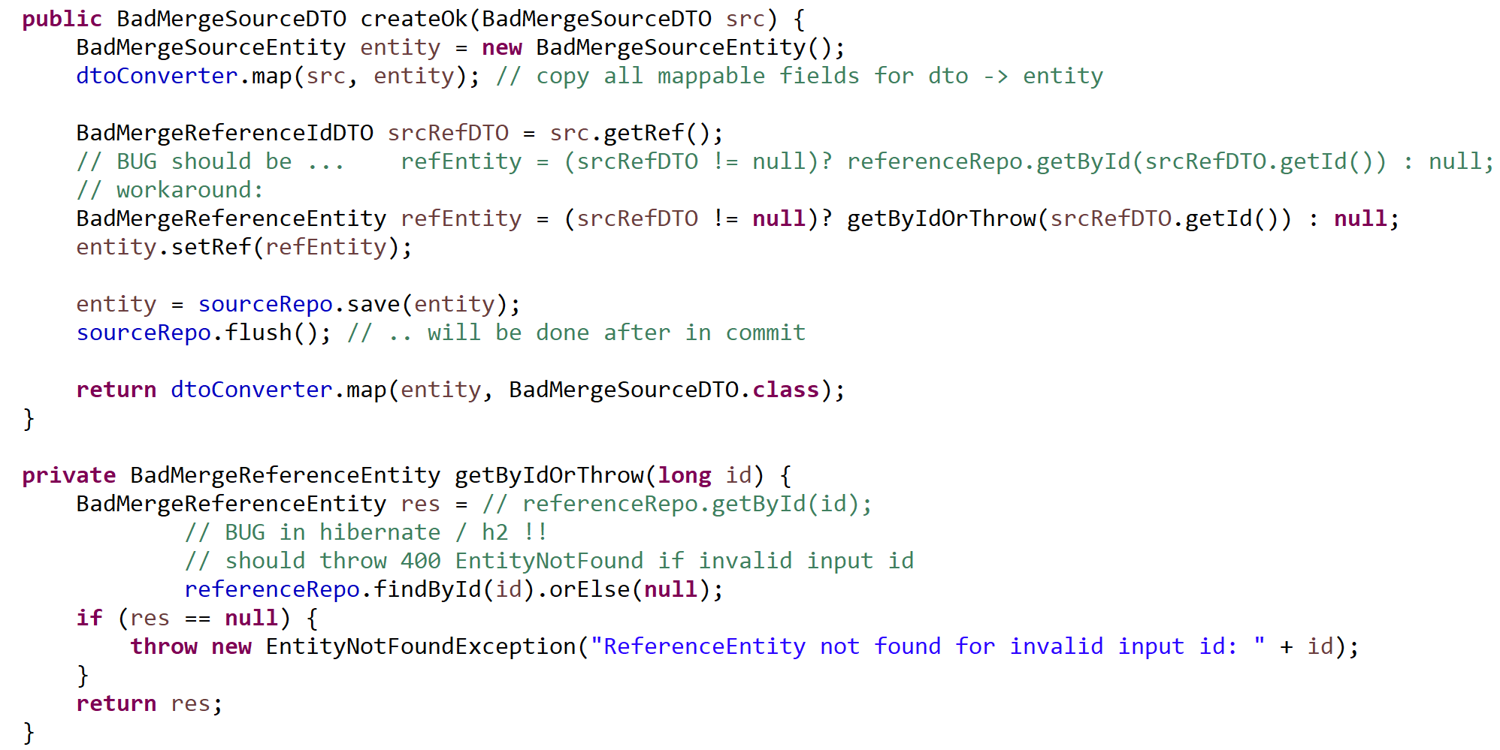

Correct mapper with findById

Slide 53

invalid « id » … bug in Hibernate getById => {id=0} BUG!! findById => null OK
Do not trust fields … hibernate use « ByteBuddyInterceptor » + store in handler

Slide 54


Getting correct 404 for invalid id

Slide 55

Save + setRef … without save(ref) (no « Cascade Create » )

Slide 56
Mapper + Hibernate + Transaction
-- NO built-in recognized support for findById() « id » <-> « entity » in JPA + springboot
NOT suitable for JPA « merge » / need business logic code
Hibernate is a MESS
BUG : put invalid « un-merge » Entity in session
BUG : no EntityNotFoundException error code
Can not see field values at debug type, use ByteBuddyInterceptors … duplicate memory needs
Switch to EclipseLink (reference implementation of JPA)

Slide 57
More problems…
Hard-coded DTO API to chose field projections (and cut other fields)
1 rule does not fit all clients

Slide 58
DTO fields computation + transfer
For some clients : not enough fields in DTO … need more
=> client loop many http calls
For some clients : too many (useless) fields in DTO … need less
=> slow on server to compute too many JDBC selects,
and transfering useless network data

Slide 59

GraphQL to the rescue ..
Switch to
java + annotation + springboot ecosystem for GraphQL
Much more powerfull & simpler than DTO + Mappers !!

Slide 60
Not enough fields in Api DTO client loop to enrich.. 1+N network calls
Call 1:
GET /api/..infos/..
Client
Client-side foreach loop
on {obj1}, {obj2} … {objN}
[ {obj1}, {obj2}, … ]
Rest Server
Need more detail on {obj1}
Call 2: GET /api/..detail/..{obj1.id}
{view-obj1}
{full-obj1}
{view-obj2}
… {enriched-obj1}
{full-obj2}
{view-objN}
{full-objN}
Call 3: GET /api/..detail/..{obj2.id}
Need more detail on {obj2}
…
Server may have FULL objs
But forgot/choosed to export
only partial projections
Call 3: GET /api/..detail/..{objN.id}
Need more detail on {objN}

Slide 61
Too Many fields in (useless) detailed DTO … server-side loop 1+N JDBC requests
Rest Server
List< …Info >
[ {obj1}, {obj2}, … ]
server-side foreach loop
on {obj1}, {obj2} … {objN}
Call
GET /api/..info1/..
Client
{view-obj1}
Need more detail on {obj1}
2 select detail..obj1.id
{view-obj2}
… {enriched-obj1}
{view-objN}
3 select detail ..obj2.id
Need more detail on {obj2}
Client does not need all
data transfered from server
…
N select detail ..obj2.in
Need more detail on {objN}

Slide 62
By-Passing « Query » « Entity » then to « DTO » … direct Query with JOINs to DTOs
Every application has a central « Search screen »
Such API must be highly optimized
Worth for back to the basics: « JPA QL » or plain old « Jdbc »
Do not optimize all apis in JDBC for maintenance/evolutivity

Slide 63

Direct JPA QL to DTO (or even Native SQL to DTO )
SELECT
p.id, p.field1, p.field2, p.ref_id, ref.field1, ref.field2
FROM direct_source_entity p
CROSS JOIN direct_reference_entity ref
WHERE p.ref_id=ref_.id
and p.field1 like ?
1 SQL request

Slide 64
GraphQL specific query on client – Answer exact from Server
http + JSON:
{ request: «
{ view-obj graphQL fields }
»
}
GraphQL Client
GraphQL Server
http + JSON:
{ data: [ {view-obj1}, {view-obj2}..
{view-objN}],
message: null, error: null
}

Slide 65
GraphQL Main Features & Benefits…
RootQuery … ~ http GET + swagger
Strongly Typed schema + documented
discovery by introspection (metadata query)
Interactive Graphiql browser
Mutations … ~ http POST/PUT/DELETE actions
Subscriptions … ~ Web socket to subscribe
SIMPLER than DTO + Mapper + Projections/Cuts dilemna
& BEST evolutivity
& BETTER performances
NO pre-defined « all-in-one client data/prepared calls »
… See next lessons

Slide 66
Conclusions
Modeling Domain Entity / Optimizing Database was « essential & difficult »
Standard JSON marshalling/unmarshalling is done via DTO classes
and entity2dto / dto2entity mapper
Mapper in way « dto2entity » need complex JPA / Transactional code
(findById / save … otherwise strange bugs appear )
Exposing API with specific DTOs (choosing projections/cuts)
looks « accidentally difficult » …. GraphQL to the rescue

